Slide 1
Banking Application
Guided by: Sandip sir
Developed and presented by : Aashritha Kondaveeti

Slide 2
Contents
Problem Statement
Functional Requirements
Flowchart
Codes
Outputs
Conclusion

Slide 3
Problem Statement
The aim of this project is to create a banking application using core Java concepts and Collection Frameworks
Problem Statement :
Create a Bank Application where you can store the details of the customer
Give the option to :
Deposit Money
Withdraw Money
Check the Balance
Display the final Balance
Display the list of customers with their final balance
Use switch to store customer details and Transaction details and minimum balance should be Rs.1000

Slide 4
Functional Requirements
Withdraw Amount
Add Customer
Withdraw amount from the given account number
Adds new Customers to the Application
Deposit Amount
Search by Account Number
Deposit Amount to the given Account Number
Search the Account by given account number and gives the details.
Display Customer Details with full balance
It will display the details of the Customer with their full balance in the account

Slide 5
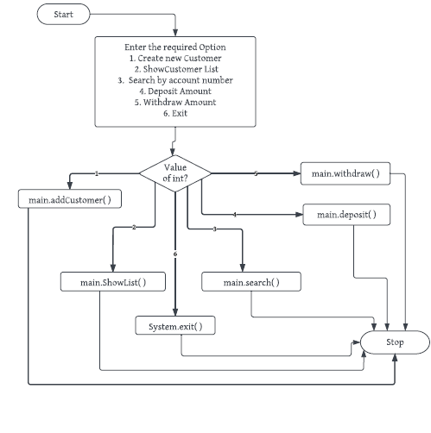
Flowchart

Slide 6
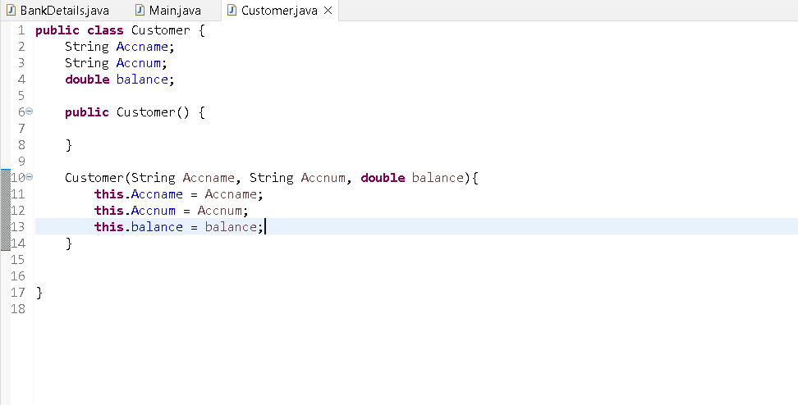
Codes
There are three classes :
1. Customer.java : In this the variables of the customer is stored
Customer.java :

Slide 7
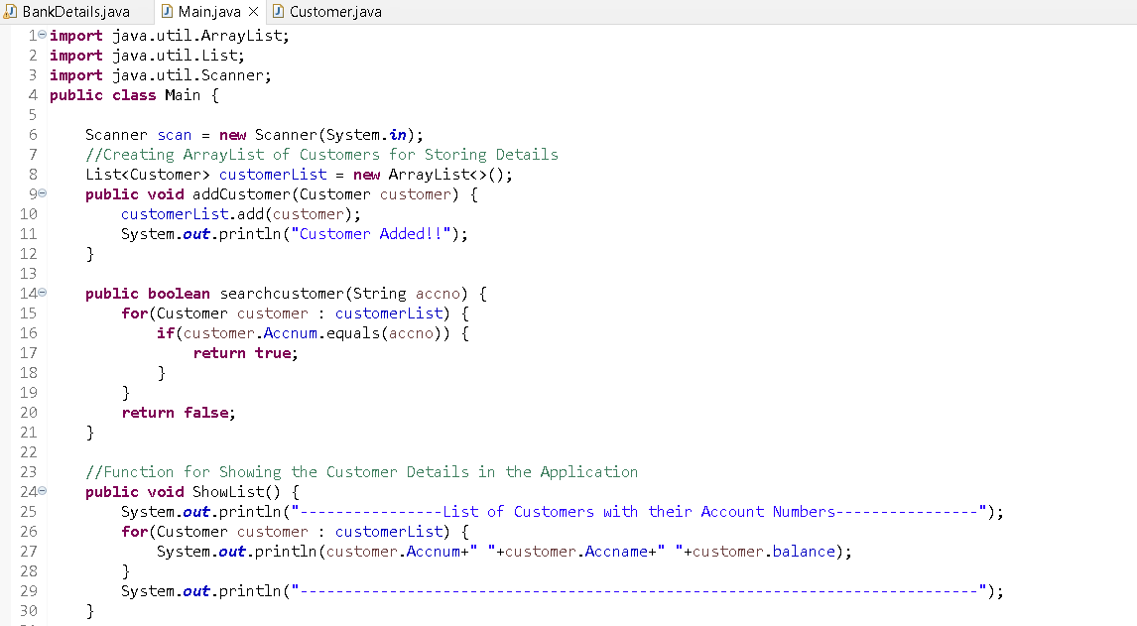
Main.java :
2. Main.java :
I have used ArrayList for storing the Customer details
I have created different functionalities like adding, searching, deposit, withdraw

Slide 8
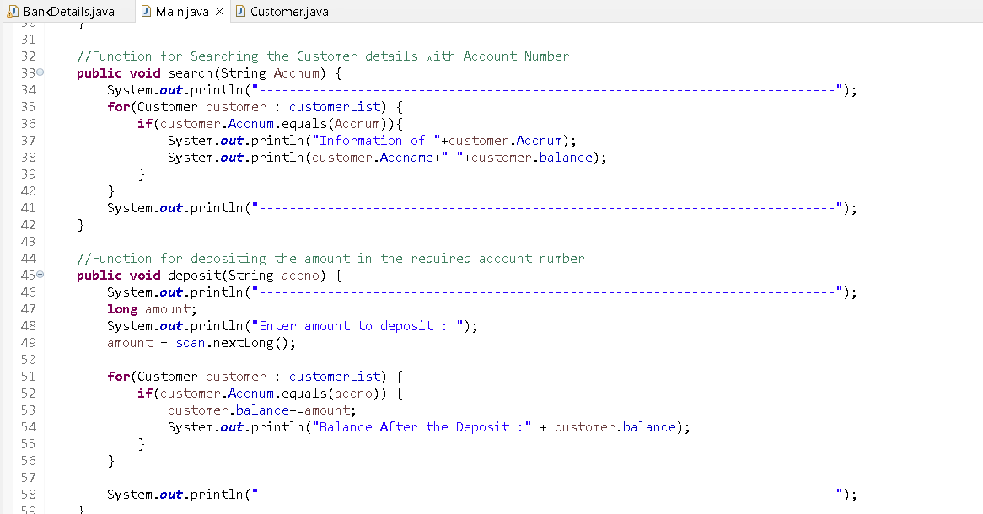

Slide 9
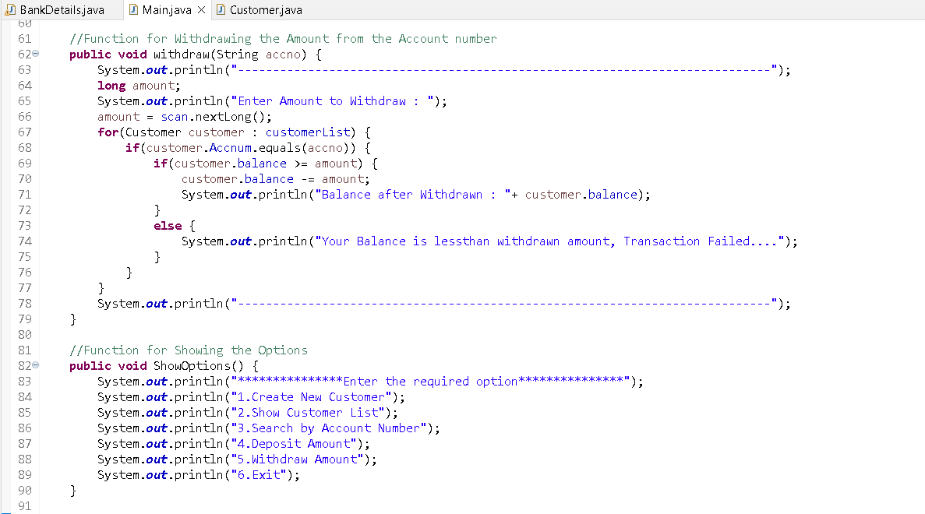

Slide 10
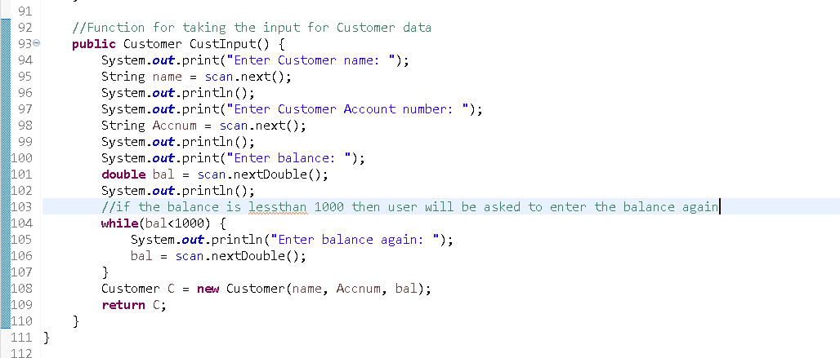

Slide 11
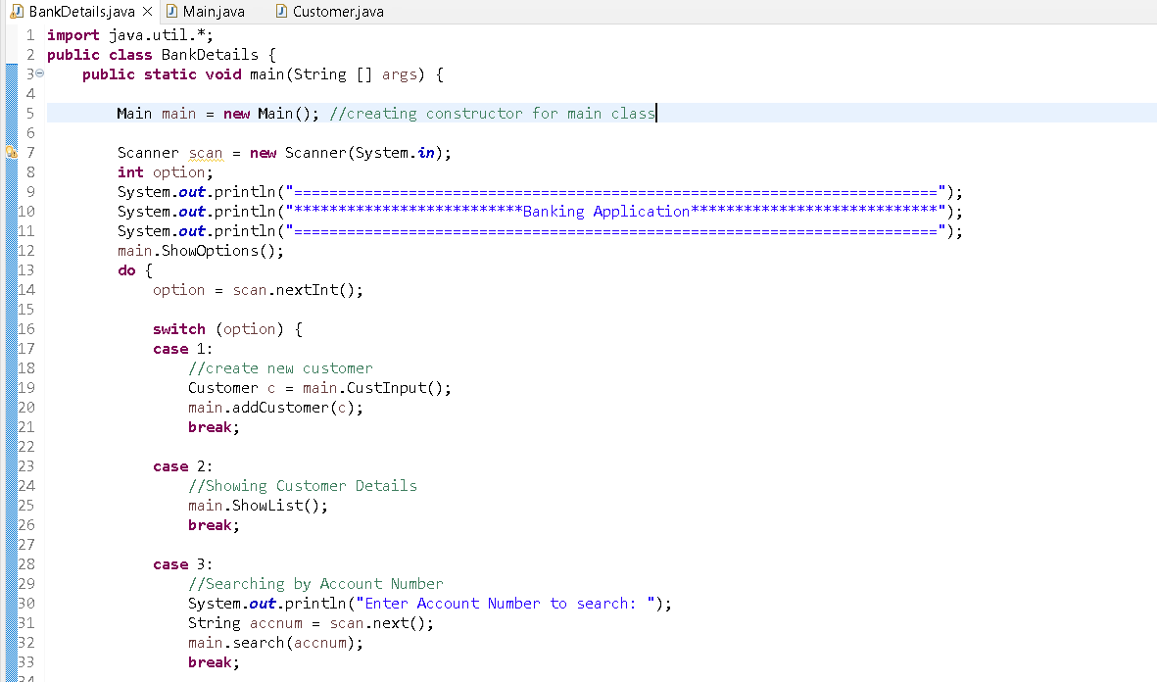
BankDetails.java :
3. BankDetails.java:
There are switch cases with function calling in this class

Slide 12
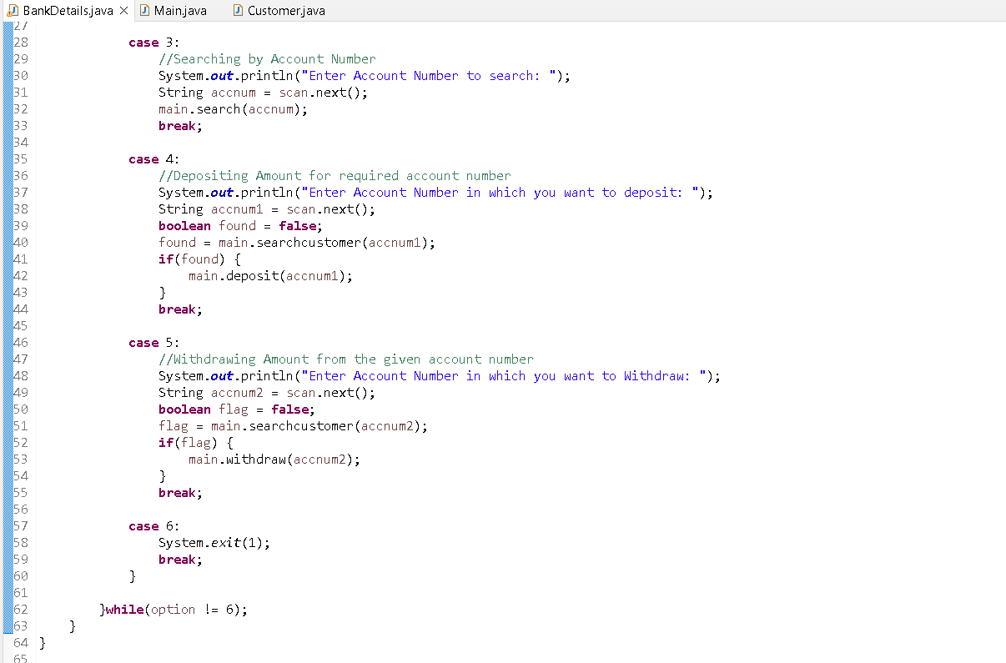

Slide 13
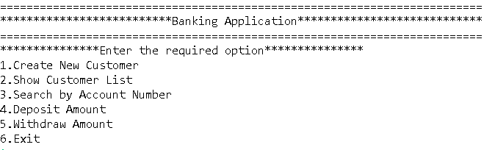
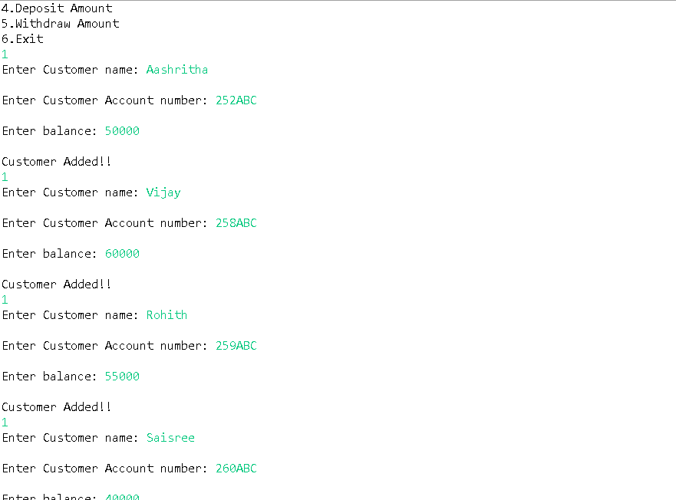
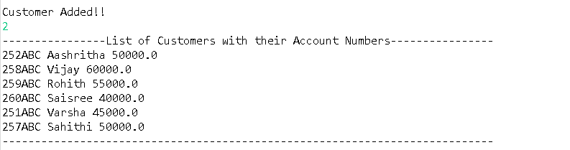
Outputs
1
2
3

Slide 14
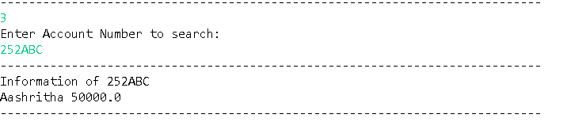
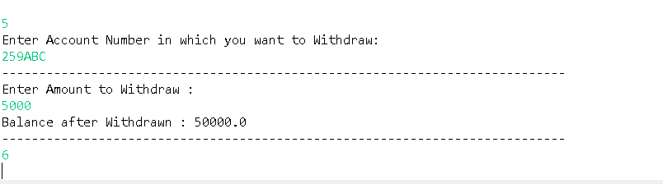
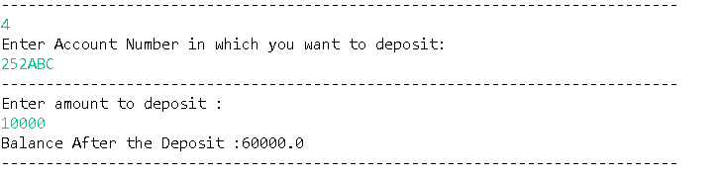
4
5
6

Slide 15


